Slide 1
CSIS – 4135: Spring 2022
Web Application Engineering
Instructor: Sujoy Chakraborty
Lecture Slides – 22

Slide 2
Working with background, images and date object

Slide 3
Outline
Controlling the background dynamically
Working with images
Date object

Slide 4
Controlling the background
The body tag has the following attributes
Bgcolor
Background
text
These attributes can be accessed and changed following the DOM hierarchy.

Slide 5
Setting the bgcolor
We can access the bgcolor as:
document.body.bgcolor
document.getElementById(“Id of the body tag”).bgcolor

Slide 6
Setting the bgcolor – cont.
<html>
<head>
<title>BGcolor setting</title>
<script>
function setBgcolor()
{
var bg = prompt("Enter bgcolor")
document.getElementById("body").bgColor = bg
}
</script>
</head>
<body id="body" onload = "setBgcolor()">
<h1>Hello World. </h1>
</body>
</html>

Slide 7
Setting the text color
We can access the body text as:
document.body.style.color
document.getElementByID(“id of the body tag”).style.color

Slide 8
Setting the text color – cont.
<html>
<head>
<title>Setting text color</title>
<script>
function setText(txtcolor)
{
document.body.style.color = txtcolor;
}
</script>
</head>
<body>
<p onclick = “setText(‘blue’)”>Blue</p>
<p onclick = “setText(‘red’)”>Red</p>
<p onclick = “setText(‘orange’)”>Orange</p>
</body>
</html>

Slide 9
Setting the backgrond
We can access the background as:
document.body.background
document.getElementById(“id of the body tag”).background

Slide 10
Setting the background – cont.
<html>
<head>
<title>Confirm box</title>
<script>
function setBkground(bgSource)
{
document.body.background = bgSource
}
</script>
</head>
<body>
<img src = "robot.png" onClick = "setBkground('robot.png')">
<img src = "cell.png" onClick = "setBkground('cell.png')">
</html>

Slide 11
Working with images
JavaScript has a built-in object called Image.
The Image object allows us to create objects that represent images created using the <img> elements.
Properties: name, border, height, width, hspace, vspace, src.

Slide 12
Working with images – cont.
An Image object can be created as:
- var objname = new image()
The most important property of an image object is src.
This designates the actual image file we will use as a source for the image object:
- objname.src = “abc.jpg”
This property can be used to dynamically change an image on the webpage.

Slide 13
Working with images – cont.
The primary use for an image object is to download an image into the cache before it is actually needed for display.
- Instance of image object is created.
- Src property is set to the name of the image to be downloaded.

Slide 14
Image Rollover
<html>
<head>
<title>Image Rollover</title>
<script>
function changePic(imgsrc)
{
document.getElementById("pic").src = imgsrc
}
</script>
</head>
<body bgcolor = "#6666FF">
<h1>Image Rollover</h1>
<img src = ”pic1.png" id = "pic" onmousemove = "changePic(pic2.png')"
onmouseout = "changePic('robot.png')">
</body>
</html>

Slide 15
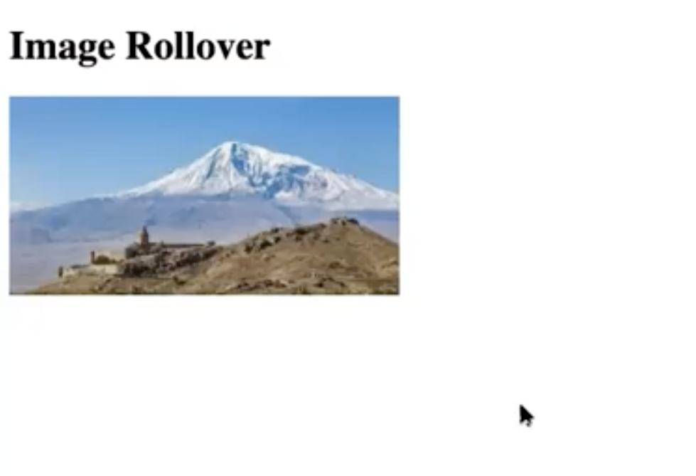

Image Rollover
Before mouse move:
After mouse move:

Slide 16
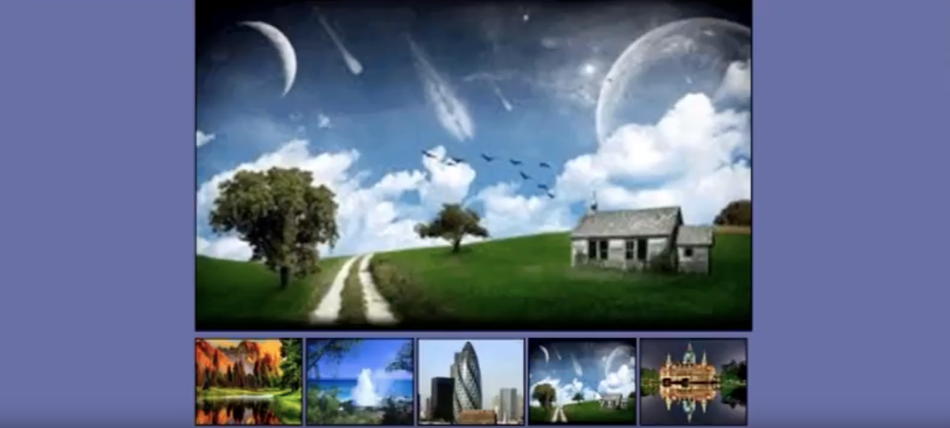
Image Preview

Slide 17
Slide show
Array of images
Main image
Next and Previous image buttons

Slide 18
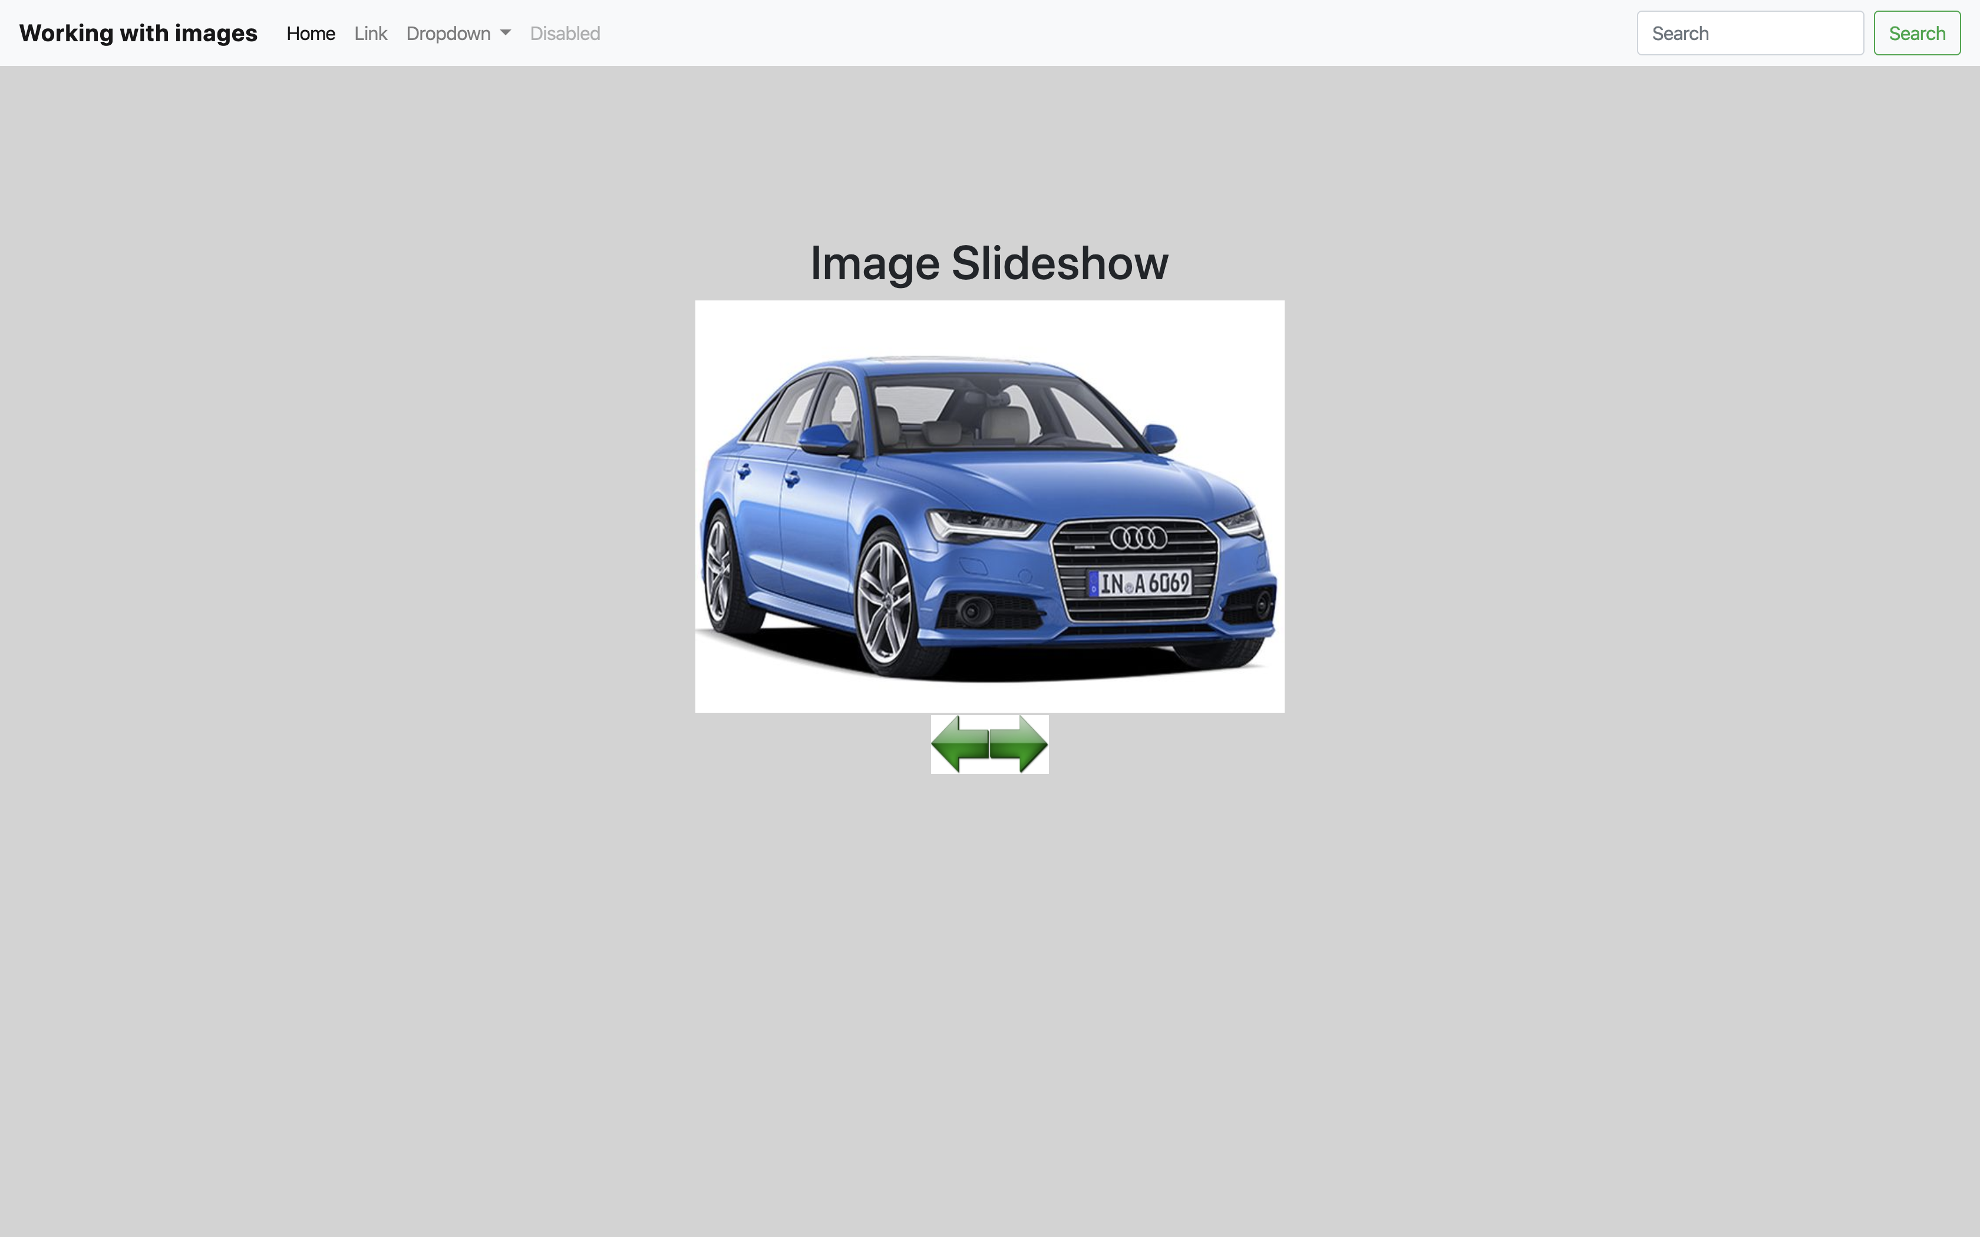
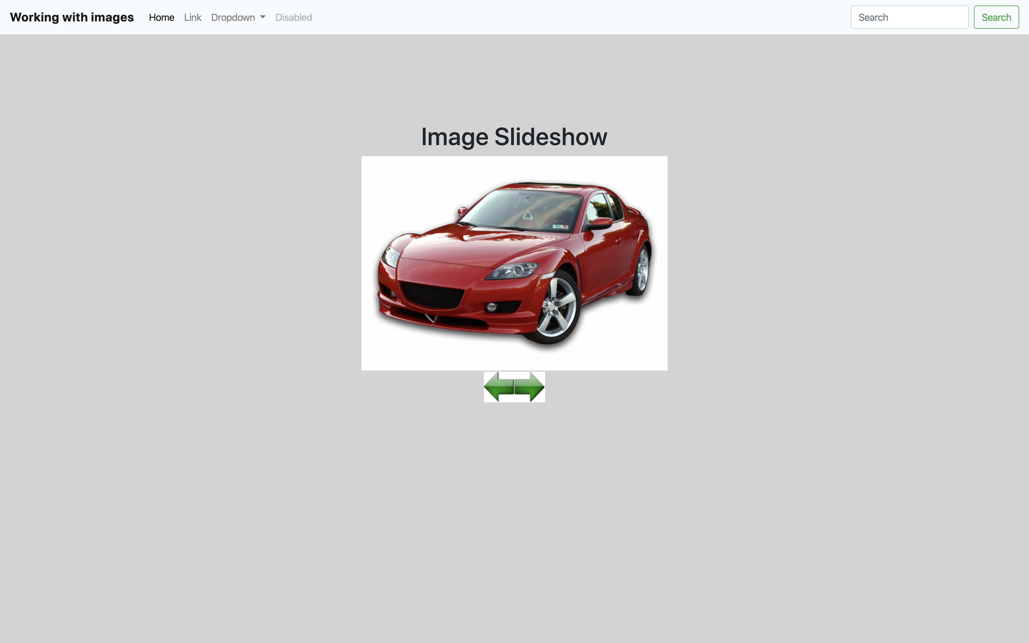
Slide show

Slide 19
Working with date object
The Date object is used to work with dates and times.
It can be used to find the current time and date.
Many time-based tasks can be performed.
Date objects are created as:
var today = new Date()

Slide 20
Date objects – cont.
Date object methods:
getDate(): Returns the day of the month (1 – 31)
getDay(): Returns the day of the week (0 – 6)
getFullYear: Returns the current year (4 digits)
getMonth(): Returns the month (0 – 11)
getHours(): Returns the hour (0 - 23)
getMilliseconds(): Returns the milliseconds (0 – 999)
getMinutes(): Returns the minutes (0 – 59)
getSeconds(): Returns the seconds (0 – 59)

Slide 21
Summary
We discussed:
Controlling the background dynamically
Bgcolor
Text
Background
Working with images
Image Rollover
Image Preview
Image Slideshow
Date object
Digital clock

Slide 22
References
Chapter 11, Beginning HTML, XHTML, CSS and JavaScript, by Duckett.
Chapter 4, 5, 7 Learn JavaScript, by Chuck Easttom.

